Slide 1

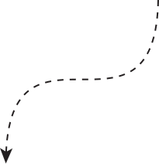


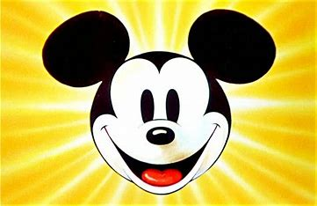
By Miguel, Stijn, Michael and Frank
Data Science
DISNEY WORLD
ASSIGNMENT

Slide 2





Agenda
Introduction
Working with github
ML predictions
Flask user input and Trip Recommendation

Slide 3

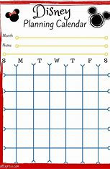
Introduction

Slide 4
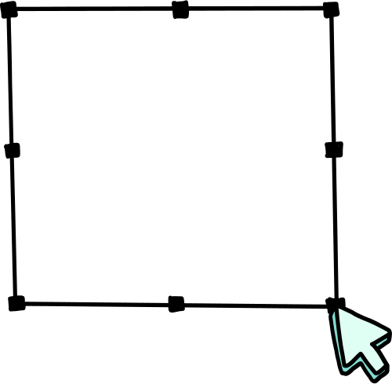
End goal
An interactive Flask application that helps users plan optimal days at Disney World.
Integration of weather forecasting, crowd prediction, and attraction preferences.
Clear visual tools (e.g., Flask) for an enhanced experience.
Trip Recommendation

Slide 5

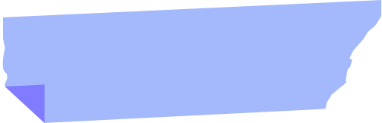

SUGGEST THE BEST DAY TO GO TO DISNEY WORLD USING A FLASK TEMPLATE
USER INPUT VIA FLASK
RANDOM FOREST
TRIP RECOMMENDATION
Create a Flask app (web-interface) to get the user preferences input
Use Machine Learning technique “Multi output Random Forest Regressor / XGBoost with scikit learn”, using weather forecasts, attraction wait times, and user preferences.
Recommend optimal visiting times by weather and attraction metrics, displayed via Flask templates.

Slide 6



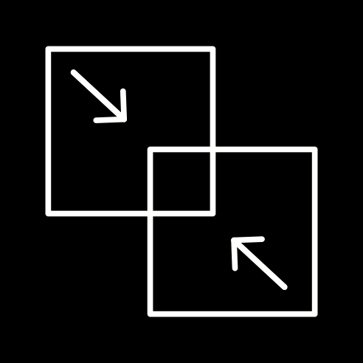
Data clean up
Feature Engineering
Machine Learning
Frontend and Output
Weather features (temperature, precipitation, ..)
Front end
Date features (hour_of_day, day_of_week, ..)
Flask routes (/home, /planning)
Weather Data
Clean Weather Data
Attraction features (Rides, ... )
User inputs: Dates, weather preferences, attractions.
api.open-meteo.com
Front end
Attraction Data
Clean Attraction Data
Metadata
data/waiting times
data/overview data
Merge Cleaned DataFrames
Feature Engineering

Slide 7
Working with github

Slide 8
Data Integration and Machine Learning Predictions

Slide 9
Flask user input and trip recommendation

Slide 10
User input
User selects dates, preferences, and attractions
Flask

Slide 11

THANK
YOU!

